Slide 1
Introduction to Machine Learning – What is Machine Learning?
Dr. Ab Mosca (they/them)
Slides based off slides courtesy of Jordan Crouser (https://jcrouser.github.io/)

Slide 2
Plan for Today
Who am I?
Who are you?
What will we do in this class?
What is Machine Learning?

Slide 3



Who Am I?

Slide 4



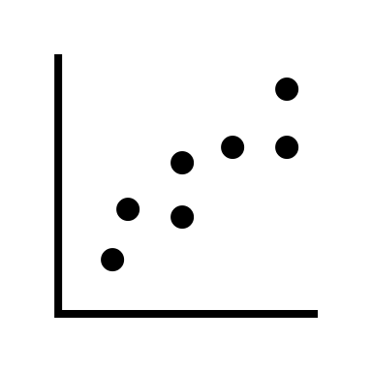

Who Am I?
Dr.

Slide 5



Who Am I?
Dr.

Slide 6
Who Are You?
Form groups of 3
Introduce yourselves (name, pronouns)
Share:
A highlight of your winter break
Find 1 thing that your entire group has in common (favorite color? hometown? left-handed? Be creative!)
After about 5 minutes we will go around, introduce ourselves, and share what each group has in common

Slide 7
Who Are You?
Form new groups of 3 (move around!)
Introduce yourselves (name, pronouns)
Share:
Would you rather be able to touch a book and instantly read it OR remember everything you’ve ever read?
After about 5 minutes we will go around, introduce ourselves, and share our would you rather answers

Slide 8
Who Are You?
Form new new groups of 3 (move around!)
Introduce yourselves (name, pronouns)
Share:
Would you rather have your dishes wash themselves or your laundry wash itself?
After about 5 minutes we will go around, introduce ourselves, and share our would you rather answers

Slide 9
What You Will Learn & Logistics

Slide 10
What is this class?
1. Understand
what ML is
(and isn’t)
2. Learn some
foundational
methods / tools
3. Be able to
choose methods
that make sense
Notes:
Understand what Machine Learning is
Learn the foundational methods and tools available
Be able to apply that knowledge to choose methods that make sense
Be familiar with some ongoing research in ML
Know how to perform analytical tasks and report your findings
Have access to guest speakers from really cool places (National labs, other schools, major companies, etc.)
Have (marketable!) experience developing useful machine learning models to solve real problems

Slide 11
**Important Info**
Course website (write this down!): https://amosca01.github.io/CAIS380ML-S24/
Office Hours
Wilson Hall 325
Wednesday 09:30 - 11:00
Thursday 14:30 - 16:30
By Appointment

Slide 12
**Important Info**
Textbook: An Introduction to Statistical Learning
See course website for instructions
Assignments:
Turn in on Gradescope (https://help.gradescope.com/article/ccbpppziu9-student-submit-work)
Due Dates: As listed on course schedule.
24hr grace period; no late submissions
Lowest homework dropped
See syllabus for revise and resubmit policy

Slide 13
**Important Info**
Assignments
Homework
Pair assignments
Graded on effort and correctness
Quizzes
Individual assignments
Can re-take as many times as wanted before deadline
In-class Activities
Graded on effort
Final Project
Small group
Graded on creativity and correctness

Slide 14
**Important Info**
I’m here to help you succeed
Please come to office hours or reach out if you need any additional support

Slide 15
Now the good stuff

Slide 16
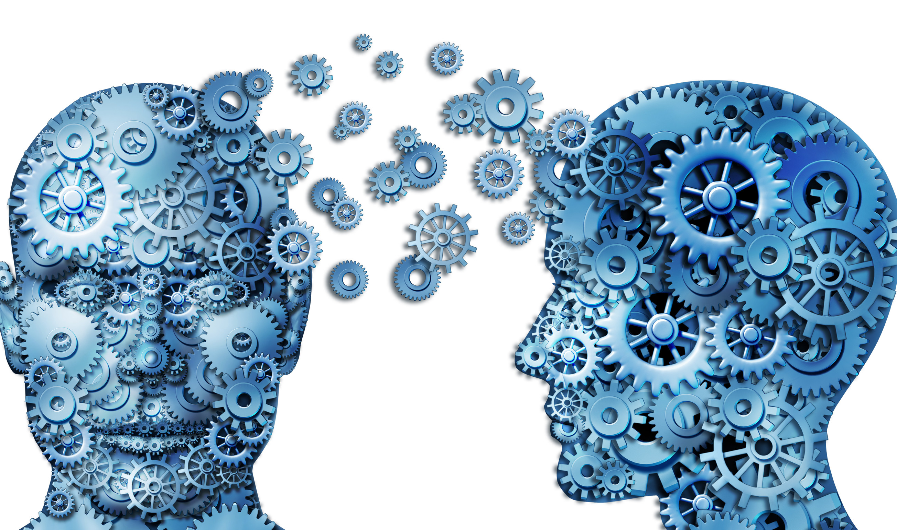
What is machine learning?
Image credit: Coursera

Slide 17
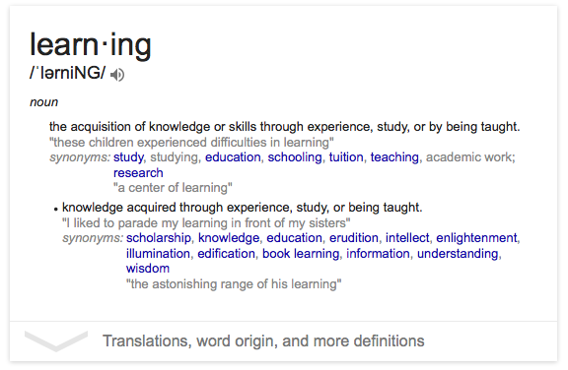
What is machine learning?

Slide 18
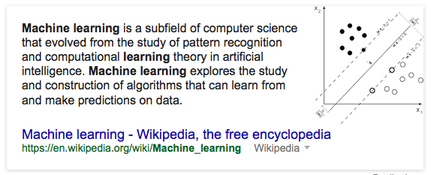
Machine learning: Wikipedia

Slide 19
Machine learning: a working definition
Machine learning is a set of computational tools for building statistical models
These models can be used to:
Group similar data points together
(clustering)
Assign new data points to the correct group (classification)
Identify the relationships between variables (regression)
Draw conclusions about the population (density estimation)
Figure out which variables are important (dimension reduction)

Slide 20
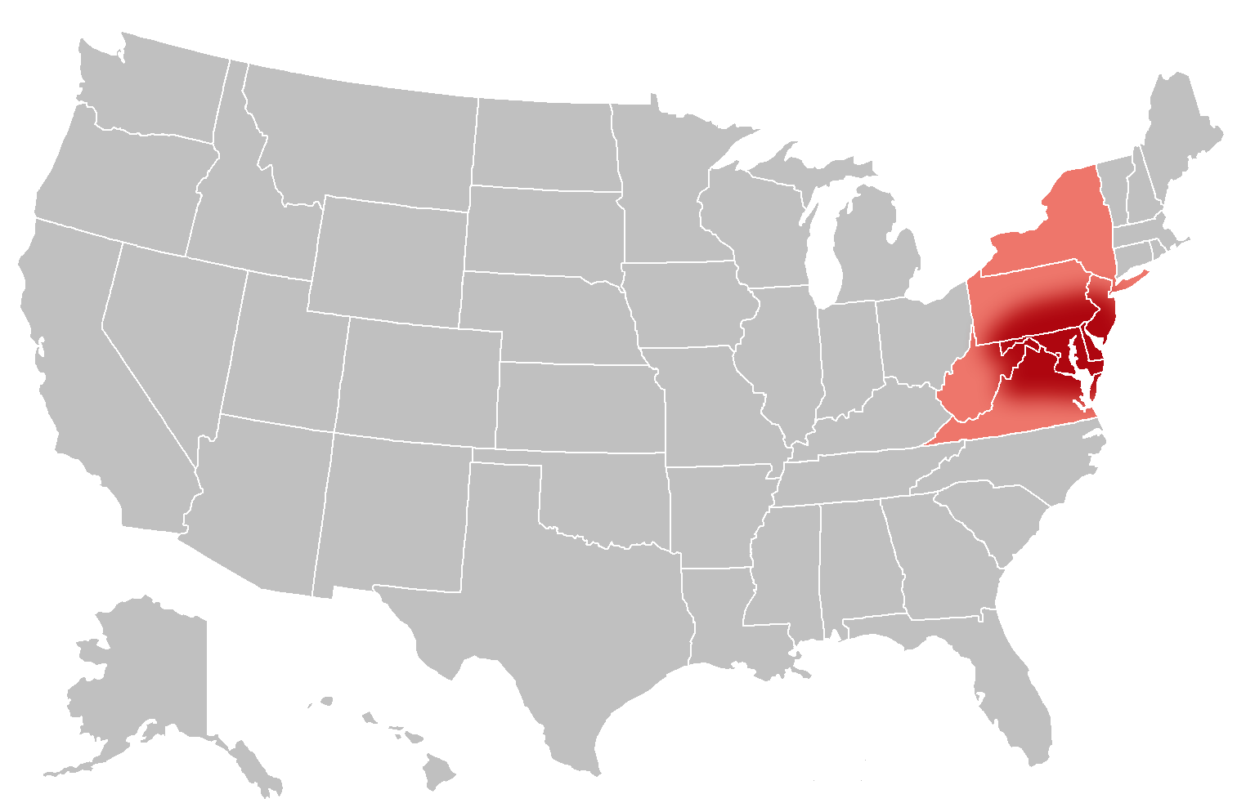

Example: men & money in the mid-Atlantic

Slide 21
Example: men & money in the mid-Atlantic
Wage dataset available in the ISLR package
Sample: 3000 male earners from the mid-Atlantic, surveyed between 2003 and 2009
Dimensions:
Year each datapoint was collected
Age of respondent
Martial status
Race
Educational attainment
Job class
Health
Whether or not they have health insurance
Wage

Slide 22
Example: men & money in the mid-Atlantic
Question: what is the effect of an earner’s age, education, and the year on his wage?
Find some friends, then go explore the data at: https://amosca01.github.io/CAIS380ML-S24/ under the Example tab

Slide 23
Example: men & money in the mid-Atlantic
https://amosca01.github.io/CAIS380ML-S24/examples/Wage.html

Slide 24
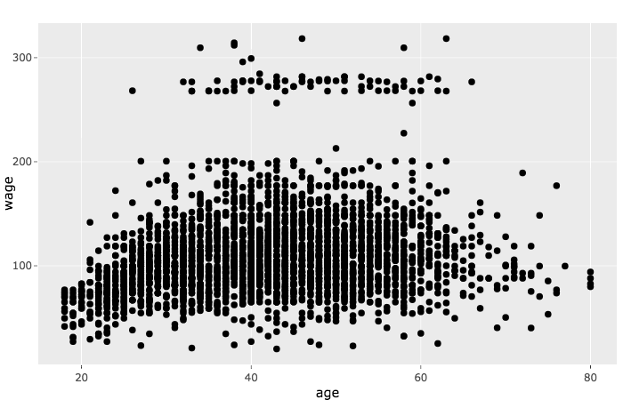
wage vs. age

Slide 25
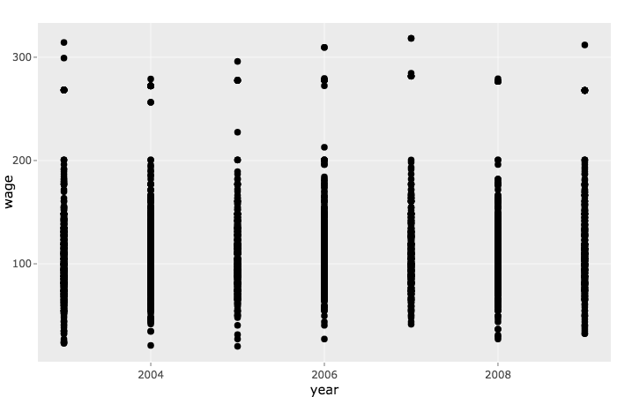
wage vs. year

Slide 26
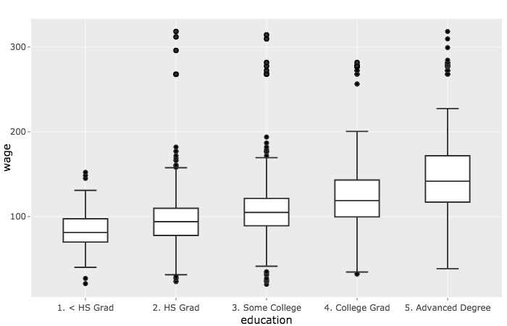
wage vs. education

Slide 27
Example: men & money in the mid-Atlantic
If we had to pick just one, we should probably use education
In reality, the best predictor is probably a combination of all three

Slide 28



Supervised machine learning
In this example, we used the value of input variables to predict the value of output variables
Another way to think about this:

Slide 29
Supervised machine learning
Goal: explain some observable phenomenon Y as a function of some set of predictors X:
Y = f(X) + ϵ
Problem: we don’t know what the function actually looks like; we have to estimate it
Machine learning: computational tools for estimating f
Notes:
Many of the ML techniques we talk about in this course will be supervised methods

Slide 30
Unsupervised machine learning
We sometimes have only input variables, but no clearly defined “response”
Can’t check (“supervise”) our analysis: unsupervised
Can’t fit a regression model (why?)
What can we do?
Notes:
Later on, we’ll also consider situations where we observe input variables, but not corresponding output variables
Because we don’t have a response variable to check (“supervise”) our analysis against, we call these unsupervised methods
In these cases, we can’t fit a regression model (why?)
So what can we do?

Slide 31
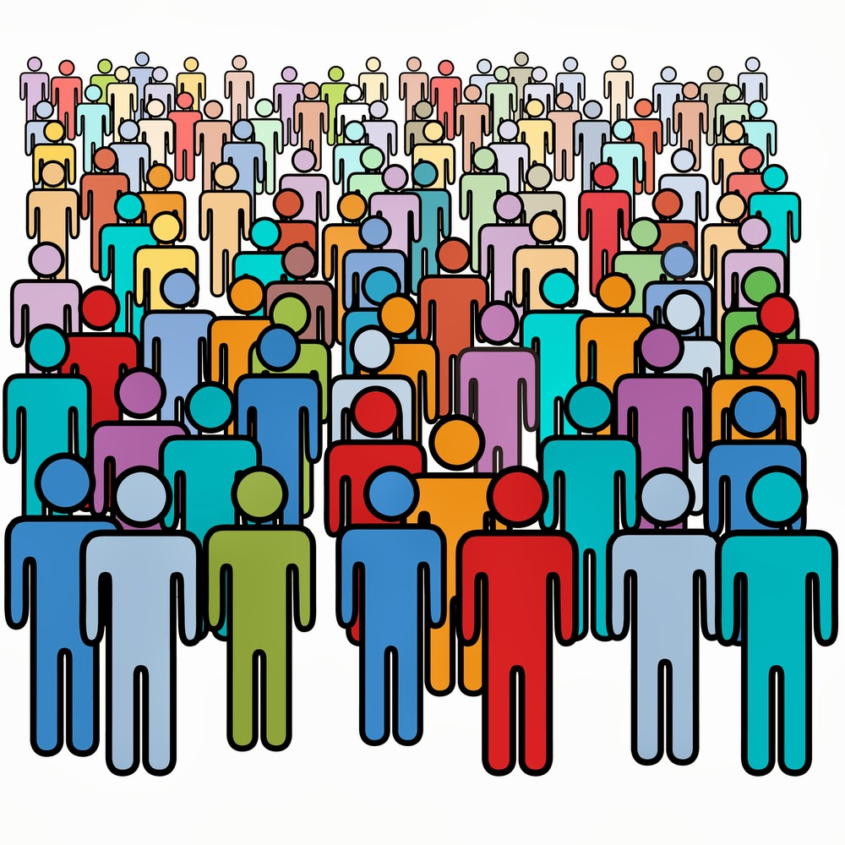

Example: personalized marketing

Slide 32
Example: personalized marketing

Slide 33
Example: personalized marketing

Slide 34
Unsupervised machine learning
Challenge: identify whether the data separates into (relatively) distinct groups
This kind of problem is called cluster analysis (Ch. 10)
Notes:
The challenging part here is to identify whether the data can be separated into groups that are relatively distinct
This kind of problem is called cluster analysis (or just “clustering” for short); we’ll talk more about that in Ch. 10

Slide 35

Data science refresher: what is “data”?

Slide 36

Data: a definition
A dataset has some set of variables available for making predictions. For example:
Tuition rates,
enrollment numbers,
public vs. private, etc.

Slide 37
Data: a definition
Each variable may be either independent or dependent:
An independent variable (iv) is not controlled or affected by another variable (e.g., time in a time-series dataset)
A dependent variable (dv) is affected by a variation in one or more associated independent variables (e.g., temperature in a region)

Slide 38
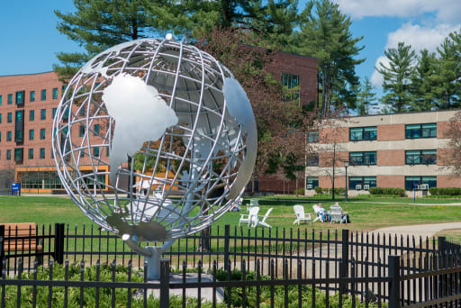
Data: a definition
A dataset also contains a set of observations (also called records) over these variables. For example:
tuition = $26,978,
enrollment = 4,239,
public, etc.

Slide 39
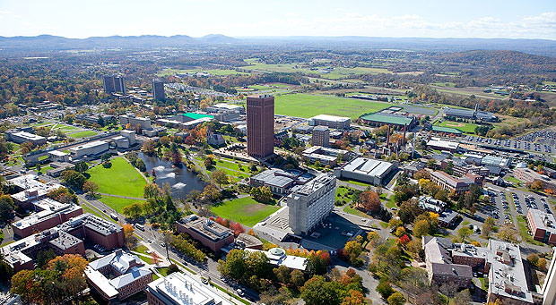

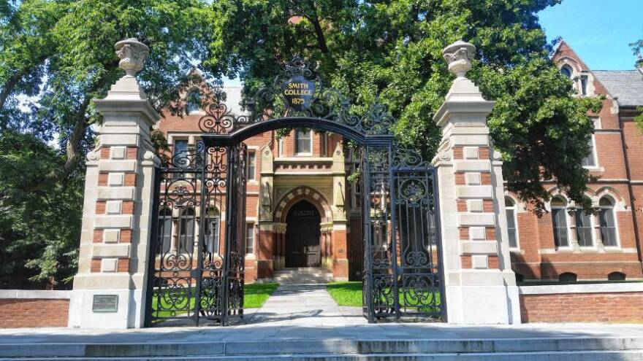

Data: a definition
A dataset also contains a set of observations (also called records) over these variables. For example:
tuition = $32,434,
enrollment = 28,635,
public, etc.
tuition = $78,438,
enrollment = 2,600
private, etc.

Slide 40
One way to think about this:
VARIABLES
 | Tuition | Enrollment | Public vs. Private | …
Smith College | $46,288 | 2,563 | private
UMass Amherst | $16,115 | 28,635 | public
Hampshire College | $48,065 | 1,400 | private
Mount Holyoke College | $43,886 | 2,189 | private
Amherst College | $50,562 | 1,792 | private
⋮
OBSERVATIONS

Slide 41
Another way to think about this
class school_obs:
def __init__(tuition, enrollment,
pub_or_priv):
self.tuition = tuition
self.enrollment = enrollment
self.pub_or_priv = pub_or_priv
smith = school_obs(46288, 2563, “private”)
umass = school_obs(16115, 28635, “public”)
VARIABLES
OBSERVATIONS

Slide 42
Basic data types
Nominal
Ordinal
Scale / Quantitative
Ratio
Interval
An unordered set {…}
of non-numeric values
For example:
Categorical (finite) data
{apple, orange, pear}
{red, green, blue}
Arbitrary (infinite) data
{“12 Main St. Boston MA”, “45 Wall St. New York NY”, …}
{“John Smith”, “Jane Doe”, …}

Slide 43
Basic data types
Nominal
Ordinal
Scale / Quantitative
Ratio
Interval
An ordered set <…>
(also known as a tuple)
For example:
Numeric: <2, 4, 6, 8>
Binary: <0, 1>
Non-numeric:
<G, PG, PG-13, R>

Slide 44
Basic data types
A numeric range […]
Ratios
Distance from “absolute zero”
Can be compared mathematically using division
For example: height, weight
Intervals
Ordered numeric elements that can be mathematically manipulated, but cannot be compared as ratios
E.g.: date, current time
Nominal
Ordinal
Scale / Quantitative
Ratio
Interval

Slide 45
Converting between basic data types
Q → O [0, 100] → <F, D, C, B, A>
O → N <F, D, C, B, A> → {C, B, F, D, A}
N → O (??)
{John, Mike, Bob} → <Bob, John, Mike>
{red, green, blue} → <blue, green, red>
O → Q (??)
Hashing?
Bob + John = ??
Discussion: what do you notice?
Readings in Information Visualization: Using Vision To Think. Card, Mackinglay, Schneiderman, 1999

Slide 46
Basic operations
Nominal (N)
Equality: = and ≠
Frequency: how often does x appear?
Ordinal (O)
Relation to other points: >, <, ≥, ≤
Distribution: inference on relative frequency
Quantitative (Q)
Other mathematical operations: (+, -, *, /, etc.)
Descriptive statistics: average, standard deviation, etc.

Slide 47
(Hopefully) familiar statistical concepts
We tend to refer to problems with a quantitative response as regression problems
When the response is qualitative (i.e. nominal or ordinal), we’re usually talking about a classification problem
Caveat: the distinction isn’t always that crisp. For example:
K-nearest neighbors (Ch. 2 and Ch. 4), which works with either
Logistic regression (Ch. 4), which estimates the probabilities of a qualitative response

Slide 48
What we’ll cover in this class
Ch. 2: Statistical Learning Overview (next class)
Ch. 3: Linear Regression
Ch. 4: Classification
Ch. 5: Resampling Methods
Ch. 6: Linear Model Selection
Ch. 7: Beyond Linearity
Ch. 8: Tree-Based Methods
Ch. 9: Support Vector Machines
Ch. 10: Unsupervised Learning
Notes:
Ch. 2 – we’ll continue with our overview of statistical learning, and explore how we know whether or not we’ve build a good model
Ch. 3 – we’ll start with some of the simplest supervised learning approaches: linear regression models. This might be familiar to those of you who have a stats background, but we’ll approach it from a somewhat different angle.
Ch. 4 – we’ll move on to classification, where we’ll consider what happens when we have a qualitative response (and so regression won’t work)
Ch. 5 – we’ll talk about how we can use resampling methods to learn more robust models that
Ch. 6 – we’ll dig into some alternative fitting procedures that can improve on the standard least-squares method we used in linear regression
Ch. 7 – we’ll generalize this to non-linear (but still additive) methods
Ch. 8 – we’ll leave additive methods behind and look at some tree-based alternatives, and tease out the benefits and drawbacks of each approach
Ch. 9 – we’ll come back to classification and take a look at Support Vector Machines, a generalization of the classifiers we looked at earlier so we can finally handle non-linear class boundaries
Ch. 10 – we’ll dabble in some unsupervised methods and talk about open research question in machine learning

Slide 49
Backgrounds
Who has experience coding?
Who has experience with statistics?

Slide 50

Preparing for labs in R
You can install R Studio on your own machine: rstudio.com

Slide 51
Preparing for labs in python
You can install Anaconda here: https://www.anaconda.com/download
I recommend developing in Spyder (which comes with the anaconda download)
You’ll need to know how to install packages

Slide 52
What I expect from you
You like difficult problems and you’re excited about “figuring stuff out”
You have a solid foundation in introductory statistics
You are proficient in coding and debugging (or are ready to work to get there)
You’re comfortable asking questions
Notes:
You enjoy grappling with difficult problems, and you’re excited about “figuring stuff out”
You have a solid foundation in introductory stats
I’m flexible about the prerequisites for this course, because I believe in your intellectual autonomy.
If you find you need a refresher, I’m happy to help you find resources
You are (or are ready to work to become) proficient in coding and debugging
Most of the programming examples in this course will be written in R (and maybe a little Python)
We’ll do crash courses in various tools and environments, but this is NOT a course in learning general programming techniques
You’re welcome to work in whatever language(s) you prefer, but I’m more helpful in the ones I know ☺
You’re comfortable asking questions

